Slide 1

Austin, TX House Listings
Project Team: Judith Landa, Neyda Morales, Sierra Sarkis, Robert Williard
Project 3 Group 7 Presentation

Slide 2
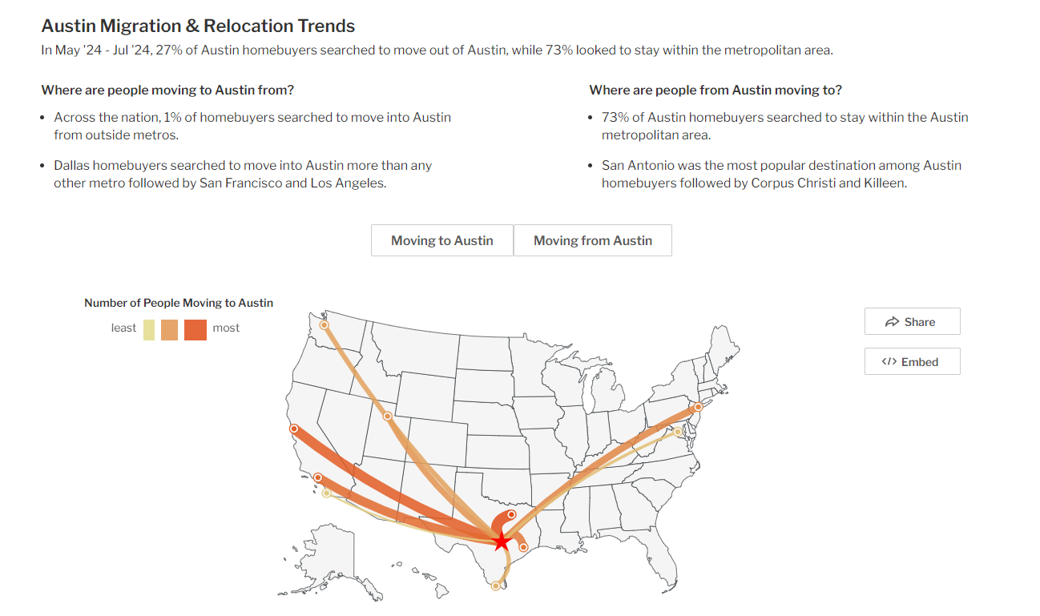
Purpose
With the boom in the Austin housing market, we wanted to showcase how the market has changed over time and what factors may impact housing purchases.
Austin Housing Market: House Prices & Trends | Redfin

Slide 3
Dataset:
Inspiration
Austin, TX House Listings
listings show how that market has changed over time
15,171 listings
Sale date data from 2018 - 2021
https://www.kaggle.com/code/threnjen/austin-housing-eda-nlp-models-visualizations
https://www.kaggle.com/code/nathanfstern/austin-house-price-prediction
Austin Housing Prices

Slide 4
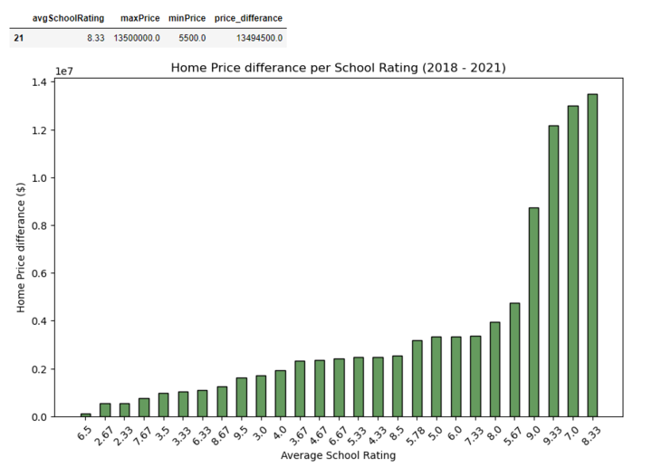
Research Question 1:
What is the biggest difference in home price, per School Rating, from 2018 - 2021?
As school ratings increase, there is a clear trend of higher home price differences
This indicates that areas with higher-rated schools have significantly higher home prices compared to areas with lower-rated schools.
Average School Rating: 8.33
Maximum Home Price: $13.5 million
Minimum Home Price: $5,500
Price Difference: $13,494,500
Suggests that there is a higher demand for homes in areas with better-rated schools

Slide 5
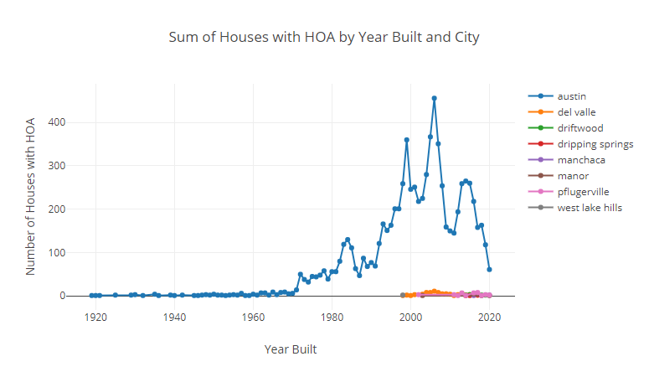
Research Question 2:
How many homes have Homeowner Associations per year built?
Austin started experiencing a rise in HOAs in the 1970s.
Surrounding cities around Austin tend to have had a small population of homes with HOA.
Between 1988 – 1998, homes with HOAs rose from 47 to 360.
In 2006, homes with HOAs reached an all-time high of 456 and has since declined to 61

Slide 6
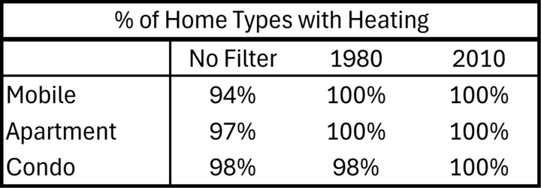
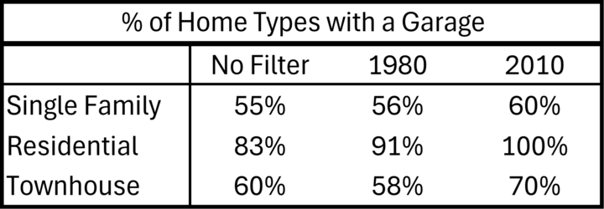
Research Question 3:
How many sales per Home Type?
As time passes, these amenities are becoming standard.
In the charts you can see that houses that were built more recent have become more likely to have certain features.

Slide 7

https://robertwill123.pythonanywhere.com/

Slide 8

Limitations/Bias
Sales data from 2018 – 2021, having historical and current data would allow for further analysis on the housing market at present
Dataset contained both rent price and home price listed as latest price all in one
Future Work
Demographic & income data of home buyers
Merge the current data source with other data captured about migration patterns in and out of Austin
Use dataset to build a predictive model of how some of these trends may change over time

Slide 9
Conclusions
Our study of the Austin housing market from 2018 to 2021 highlights the following:
A strong link between school ratings and home prices, where homes near top-rated schools saw price differences as high as $13.5 million, indicating a significant demand for properties in these areas.
The rise of Homeowner Associations (HOAs) in Austin peaked in 2006, but has since declined, reflecting a shift in buyer preferences toward more modern, standard amenities.
Surrounding areas have fewer homes with HOAs, suggesting different market dynamics.
Finally, by expanding the analysis with more recent data, demographic and income information, migration patterns, and predictive models could provide deeper insights into how these trends may shape the future of the Austin housing market.

Slide 10
Works Cited
Austin Housing Market: House Prices & Trends | Redfin
https://www.austintexas.gov/sites/default/files/files/Housing/Austin%20HMA_final.pdf
https://www.marekbros.com/company/story/1990s#:~:text=During%20the%2090s%2C%20Texas%20was,central%20location%20to%20the%20state
https://www.fool.com/the-ascent/mortgages/subprime-mortgage-crisis/#:~:text=The%20subprime%20mortgage%20crisis%20was,to%20the%20global%20financial%20system.

